Slide 1



Query Preserving Graph Compression
Wenfei Fan^{1,2} Jianzhong Li² Xin Wang¹ Yinghui Wu^{1,3}
¹University of Edinburgh
²Harbin Institute of Technology
³University of California, Santa Barbara

Slide 2
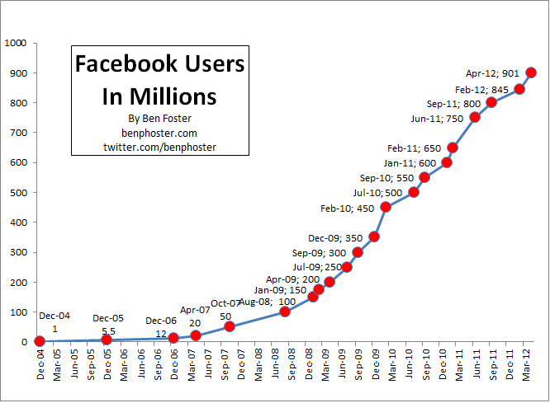
Querying Real-life Graphs
Real life graphs as “Big Data”
Complexities of several common graph queries
  NP-complete for subgraph isomorphism
  Quadratic for simulation queries
  Cubic time for bounded simulation queries
  O(|V|+|E|) for reachability queries
Indexing techniques
theoretically hard to reduce!
Index | Query time | time (Index) | Size (Index)
TC | O(1) | O(|V||E|) | O(|V|²)
GRIPP | O(|E|-|V|) | O(|V|+|E|) | O(|V|+|E|)
Tree Cover | O(log|V|) | O(|V||E|) | O(|V|²)
2-Hop | O(|E|^{1/2}) | O(|V|³ |TC|) | O(|V||E|^{1/2})
3-Hop | O(log|V| + k) | O(k|V|² |Con(G)| ) | O(|V|k)
Querying real-life graphs is prohibitively expensive
3

Slide 3
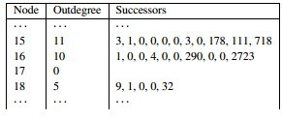
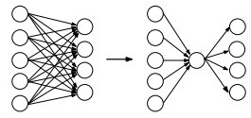
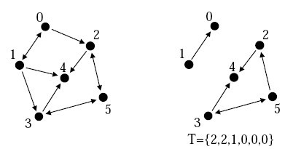
Graph compression techniques
General graph compression
  encoding via node ordering
  extrinsic information-dependent
  lossless compression
Query-friendly compression (for e.g., neighborhood queries)
  construct compact data structures
  require decompression and algorithm revision
Compression for a query class?
require decompression or revision of evaluation algorithms
4
Notes:
We may consider using data compression techniques to reduce the size of the problem.
General Graph compression has been proposed for web graphs and social graphs, by encoding the graphs into compact data structures via node ordering determined by extrinsic information, such as lexicographic URL and hosts
To overcome the limitation…
Observe that users often adopt a class of queries when querying data graphs. Can we develop a compression method that preserve the information only related with the specified query class?

Slide 4




Querying a recommendation network
preserving information only relevant to queries
MSA₁
MSA_{r}
MSA₂
FA
BSA₁
BSA_{r}
BSA₂
BSA
2
C
FA_{r}
FA’_{r}
FA₁
FA₂
FA₃
FA₄
Q_{p}
…
C₁
C_{r}
C₂
G
C₃
C’_{r}
C_{k}
5
Directly querying a compressed graph
Notes:
Explain simulation and bounded simulation queries.
Illustrate the compressed graphs and query result.

Slide 5
outline
Querying Preserving Graph Compression
  compress graphs while preserving query results
  Reachability preserving compression
  Graph pattern preserving compression
  Incremental query preserving compression
Experimental study
Conclusion
Query-preserving Graph Compression
2
Notes:
We found this method may reduce the real life graphs significantly, and

Slide 6
Query-preserving compression
Query Preserving Graph Compression, a triple <R, F, P> where
  R: a compression function,
  F: L_{q}->L_{q} is a query rewriting function, where L_{q} denotes a class of graph queries (in the same class)
  P: a post-processing function
For any graph G, Gr = R(G) s.t. for all Q ∈ L_{q},
  Q(G) = P(Q’(Gr)), and
  Any query evaluation algorithm for Q can be directly used to compute Q’(Gr), without decompressing Gr.
Lossy compression;
Gr is not necessarily a subgraph of G;
Gr can be directly queried without decompression
rather than to restore the original graph
Indexing and optimization techniques can be directly applied to Gr
Compression related to a class of queries of users’ choice
6
Notes:
We generate a compressed graph that can be directly queried, instead of a compact data structure which typically needs to be decompressed for graph querying tasks.

Slide 7

















Query-preserving compression
query-preserving compression
R (compression)
G
Gr
…
direct querying
query rewriting
Q
Q’
post processing
Q(G)
Q’(Gr)
P (post-processing)
generic, once for all compression
7

Slide 8







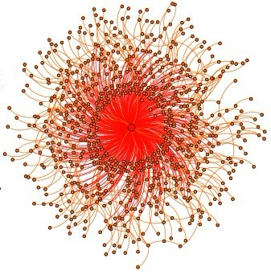
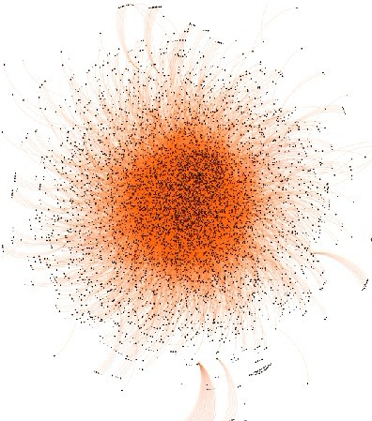
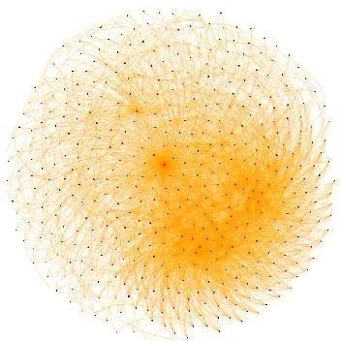

a tale of two queries…
R
R
G
Gr
G
Gr
Q_{R}
Q_{R}’
Q_{P}
Q_{P}’
P
Q(G)
Q_{R}’(Gr)
Q(G)
Q_{P}’(Gr)
Reachability preserving
Compression
Q_{R}: reachability queries
- R reduce G by 95% in average
in O(|V||E|) time
F is in O(1) time
- P: not needed
Graph Pattern preserving
Compression
- Q_{P} : graph pattern queries
- R reduce G by 57% in average in O(E| log|V|) time
- F: identify mapping
- P: linear time
8
Notes:
Apply the idea to two commonly used graph queries: reachability and graph pattern queries.

Slide 9
Reachability preserving compression
Reachability preserving compression <R,F>
  R is in quadratic time
  F is in constant time
  no post-processing P is required.
Reachability equivalence relation
  reachability relation R_{e}: a node pair (u,v) ∈R_{e} iff they have the same set of ancestors and descendants in G.
  for any graph G, there is a unique maximum R_{e}, i.e., the reachability equivalence relation of G
Query preserving compression for reachability queries
9

Slide 10
Reachability preserving compression
A reachability preserving compression <R,F> for G
  R maps each node v in G to its reachability equivalence class [v] in Gr, and each edge to an edge between two equivalence classes (if necessary)
  F maps each node in Q_{R} to its equivalence class in Gr
Correctness:
  |Gr| ≤ |G|
  For any query Q_{R}(v,w) over G, v can reach w iff R(v) can reach R(w) in Gr
Nodes in Gr denote equivalence classes
Reduction: 95% in average for reachability queries
10

Slide 11






Reachability preserving compression: algorithm and example
MSA₁
C1
MSA₁
MSA₂
Q_{R}
MSA₁
MSA₂
BSA₁
BSA₂
Compute Re and its reduced partition
Construct a node for each node set in the partition
Construct Gr
O(|V||E|)
BSA₁
BSA₂
FA₁
FA₃
FA₄
FA₁
FA₂
FA₃
FA₄
…
…
C₁
C₂
FA₂
C₃
C₄
C_{k}
C₁
C₂
C₃
C_{k}

Slide 12

Graph Pattern Preserving Compression
Graph pattern preserving compression <R,F,P>, in which for any graph G(V,E,L),
  R is in O(|E|log|V|),
  F is the identity mapping
  P is in linear time in the size of the query answer.
Bisimulation relation: a binary relation B over V of G, s.t for each node pair (u,v) ∈B,
  L(u) = L(v)
  for each edge (u,u’) ∈ E, there exists (v,v’) ∈ E, s.t. (u’,v’) ∈ B,
  for each edge (v,v’) ∈ E, there exists (u,u’) ∈ E, s.t. (u’,v’) ∈ B
Bisimulation equivalence relation Rb: the unique maximum bisimulation relation
Equivalence relation
A₁
A₂
A₃
A₄
A₅
B₁
B₂
B₃
B₄
B₅
C₁
D₁
C₂
D₂
C₃
C₄
G₁
G₂
12

Slide 13
Compressing graphs via bisimulation
The pattern preserving compression <R,F, P>
  R(G) = G_{r}, where each node in Gr represents an equivalence class [v] of a node v in G, and there is an edge ([u],[v]) in G_{r} if (u,v) is an edge in G.
  F(Q_{p}) = Q_{p}, i.e., identity mapping.
  P: for each (v_{p}, [v])∈Q_{p}(G_{r}), and each v’ ∈[v], (v_{p},v’) ∈ Q_{p}(G)
Correctness: for any pattern query Q_{p}, Q_{p}(G) = P(Q_{p}(G_{r})).
Making use of the reverse of R: nodes in Gr and Q( G ) are expanded to nodes in their equivalence classes
Reduction: 57% in average for graph pattern matching
13
Notes:
Notation of bisimulation
Bisimulation equivalence relation

Slide 14


Graph Pattern Preserving Compression: algorithm
A₁
A₂ …
A_{k}
A_{k+1}
MSA₁
MSA_{r}
MSA₂
BSA
FA
2
B₁
B₂
Q_{p}
B₃
…B_{k}
C
Compute the bisimulation equivalence relation Rb and its induced partition P: initialize and refine P w.r.t Rb until fixpoint
Construct Gr
BSA₁
BSA_{r}
BSA₂
FA₁
FA_{r}
FA₂
FA₃
FA’_{r}
FA₄
O(|E|log|V|)
…
C₁
C_{r}
C₂
G
C₃
C’_{r}
C_{k}
14
Directly querying a compressed graph
Notes:
Explain simulation and bounded simulation queries.
Illustrate the compressed graphs and query result.
Refinement condition: make sure for every block connected by an edge, for every node in the parent block, there is a child of it in the child block

Slide 15
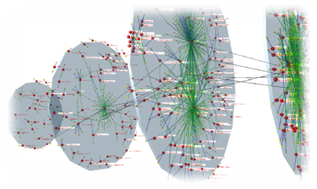

Incremental Graph Compression
5%/week in Web graphs
Real-life data are changing and evolving…
Incremental Graph Compression:
  compute changes ∆Gr to Gr, s.t.,
  Gr⊕∆Gr = R (G⊕∆G).
  update Gr without recompressing G⊕∆G
Affected area: the changes in the input ∆G and the output Gr
  |AFF| = |∆Gr| + |∆G|
bounded and unbounded problem
  expressible by f(|AFF|)?
Complexity measurement?
R
G
Gr
∆G
Incremental
Graph Compression
∆Gr
R(G⊕∆G)
Gr⊕∆Gr
Compressed once and incrementally maintained
15

Slide 16

Incremental Reachability Preserving Compression
Incremental reachability preserving compression (RCM)
  unbounded even for unit update, i.e., a single edge insertion and deletion
RCM is solvable in O(|AFF||Gr|) time without decompressing Gr
  Reduction from single source reachability problem
  1. Update topological ranking, initialize AFF
  2. (iteratively) split/merge nodes and update Gr
FA₁
C₁
FA₁
FA₁
C₁
FA₂
FA₂
C₂
C₁
FA₂
C₂
C₁
C₁
FA₂
C₂
FA₁
FA₂
C₂
FA₂
C₂
G
Gr
Gr’
Gr’’
16

Slide 17

Incremental Graph Pattern Preserving Compression
Incremental pattern preserving compression (PCM) is unbounded even for unit update
RCM is solvable in O(|AFF|²+|Gr|) time without the need to access the original graph G
  1. Update node ranking, initialize AFF
MSA₁
MSA₂
MSA₁
G
MSA₂
BSA₁
BSA₂
  2. Iteratively split/merge nodes in Gr and update AFF
BSA₁
BSA₂
C₂
  Affected area
FA₂
FA₁
FA₃
FA₄
FA₁
FA₂
FA₃
FA₄
…
…
C₁
C₃
C₄
G_{q}
C₁
C₂
C₃
C₄
17
Incremental compression without recomputation

Slide 18
Experimental Evaluation
Experimental setting
  Real-life datasets: Facebook, Amazon, YouTube, wikiVote, wikiTalk, socEpinions; NotreDame, P2P, Internet; citHepTh, Citation
  Synthetic data, with randomly generated updates.
  Pattern generator, controlled by the number of nodes, edges, predicates and bounds on edges
Problem | Batch | Incremental
Reachability Preserving Compression | Compression_{R} | IncRCM
Transitive compression | AHO
Pattern Preserving Compression | Compression_{B} | IncPCM
Query evaluation | BFS,BiBFS; Match | IncBMatch
compression ratio, memory reduction,
query time, and incremental maintenance
18

Slide 19
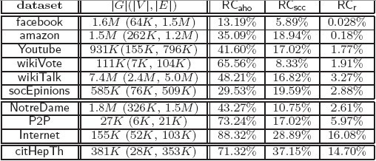
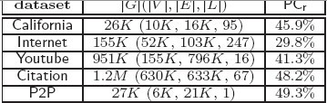
Experimental Results I: compression ratio
in average 5%
Reachability preserving compression
Graph Patten preserving compression
reduce SCC graphs by 81% in average
reduce SCC graphs by 81% in average
Perform best on social networks due to high connectivity
in average 43%
Perform best on Internet
19

Slide 20
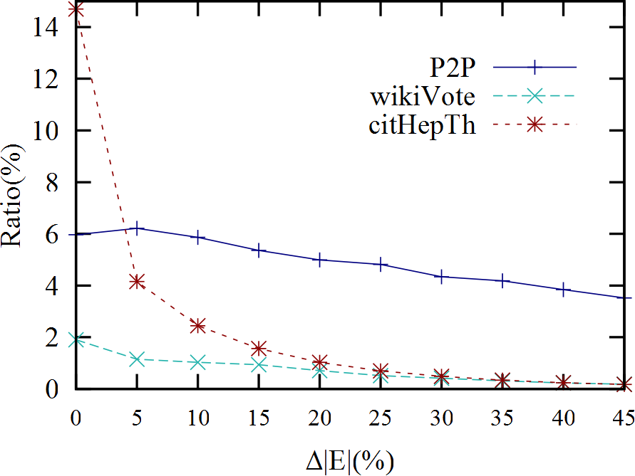
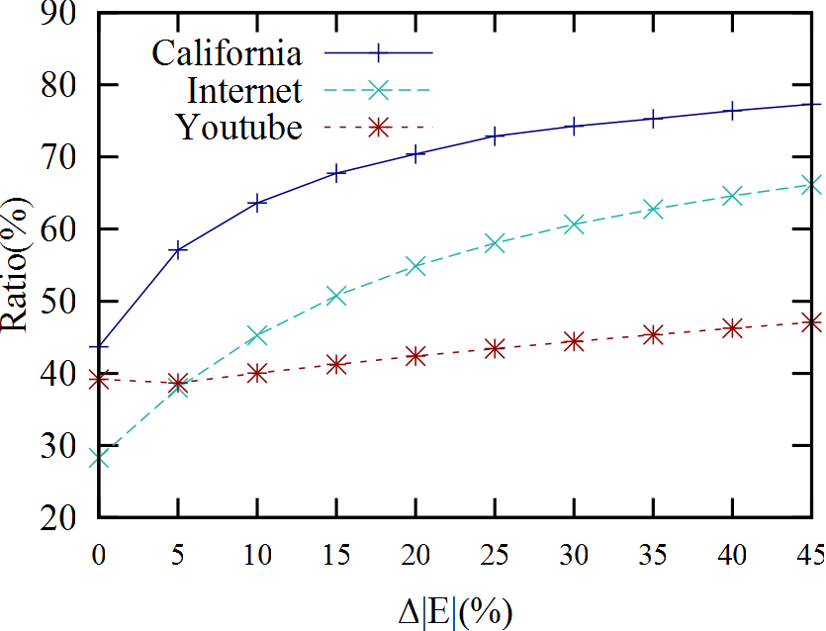
Experimental Results I: compression ratio
Reachability preserving compression
ratio w.r.t edge increment
Pattern preserving compression
ratio w.r.t edge increment
20

Slide 21
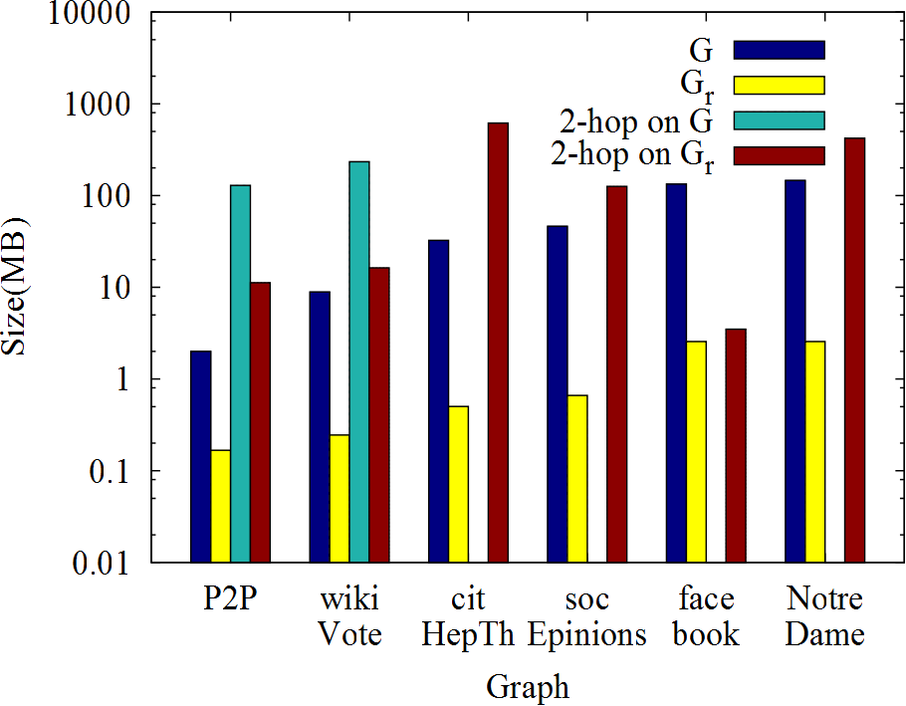
Experimental Results I: compression ratio
2-hop as index
Reduction: 92% of the memory of G in average
21

Slide 22
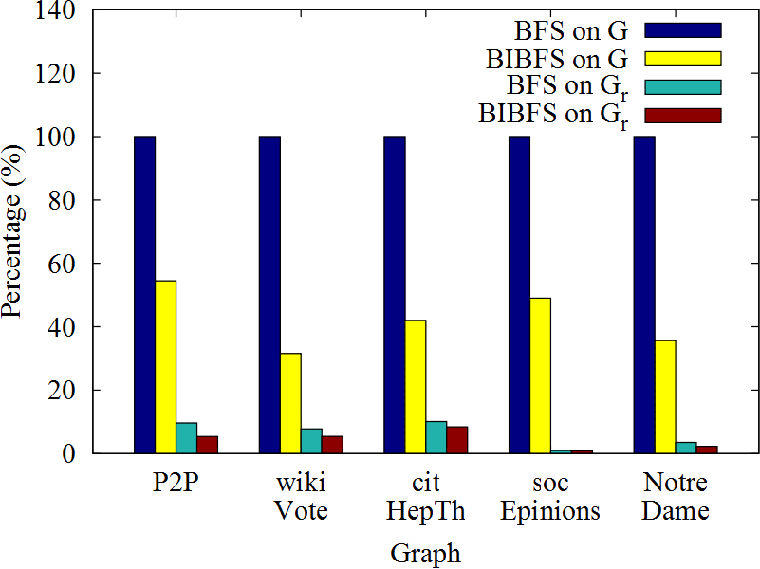
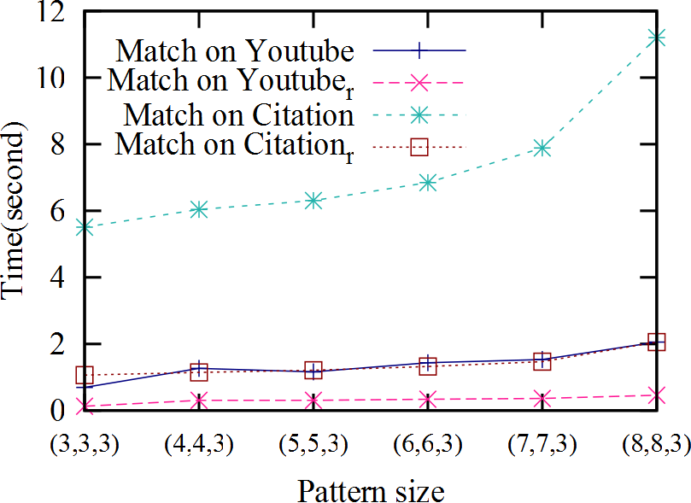
Experimental Results II: query evaluation
Reachability preserving compression
Pattern preserving compression
Reduction: 70% of the querying time over G in average
22

Slide 23
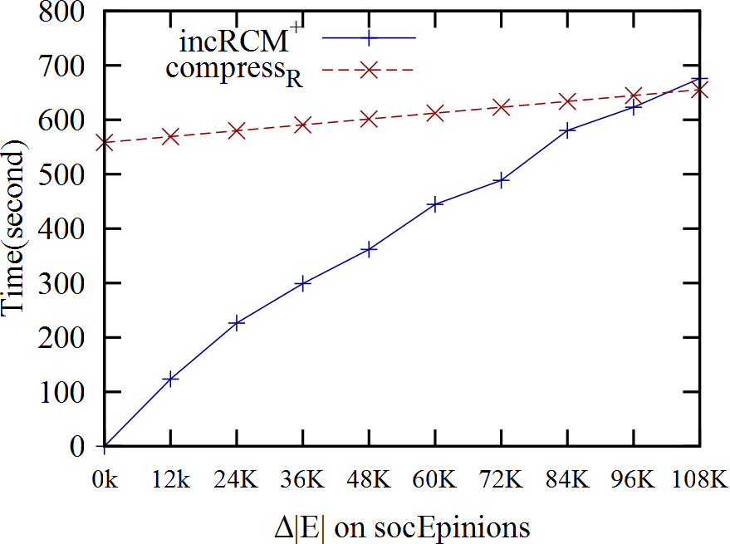
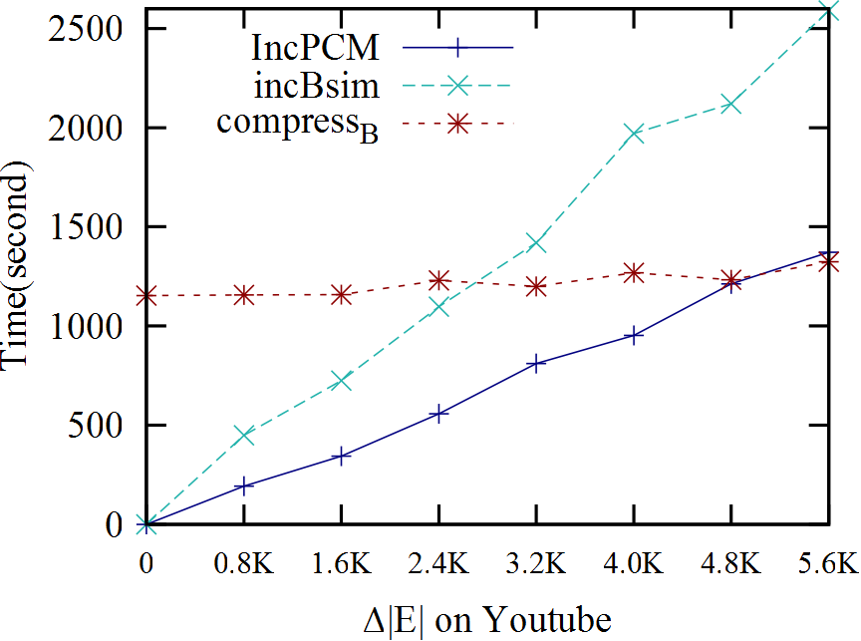
Experimental Results III: Incremental compression
Changes up to 22%
Incremental reachability
preserving compression
w.r.t edge insertions
Incremental graph pattern
preserving compression
w.r.t batch updates
The compressed graphs can be efficiently maintained
23

Slide 24

Conclusion
Querying preserving graph compression
  directly query compressed graph without decompression
  Reachability preserving compression
  Graph pattern preserving compression
Incremental query preserving compression
  Incrementally update compressed graphs without decompression
Future work
  Query-preserving compression for other queries
  Testing the compression techniques over more real-life datasets
  Optimizations for incremental compression techniques
  Extending the techniques to distributed graph querying
Query preserving compression: A promising approach to
coping with Big Data
24
Notes:
In this talk i…

Slide 25


Query preserving graph compression
Thank you!

Slide 26
Subgraph isomorphism and Graph Simulation
Node label equivalence
Edge-to-edge function/relation
A
A
E
D
E
D
B
B
B
v₁
v₂
B
B
B
D
E
D
E
A
A
P
G
P
G
Capable enough?
Identical label matching, edge-to-edge function/relations

